Slide 1
Final Project - Customer Analysis
Master Degree in Computer Science, ICT Solutions Architect curriculum
Data Mining (a.y. 2020/21)
Jacopo Massa
Giulio Purgatorio

Slide 2

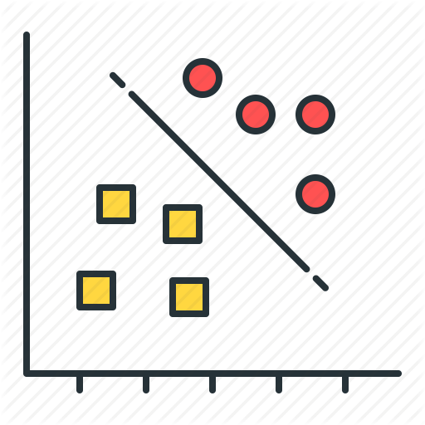


Task 1
Data Understanding and Preparation
Task 2
Clustering Analysis
Task 3
Predictive Analysis
Task 4
Sequential Pattern and Association Rules Mining

Slide 3
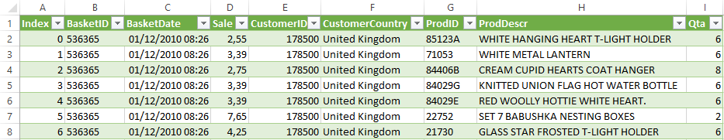
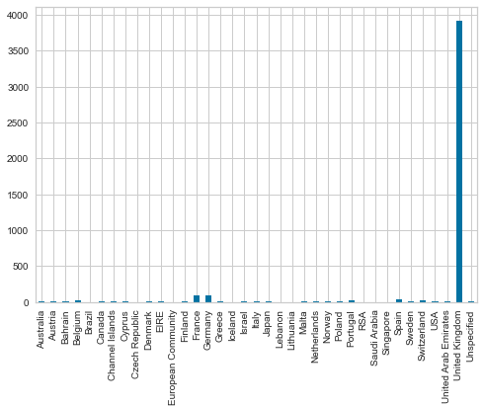
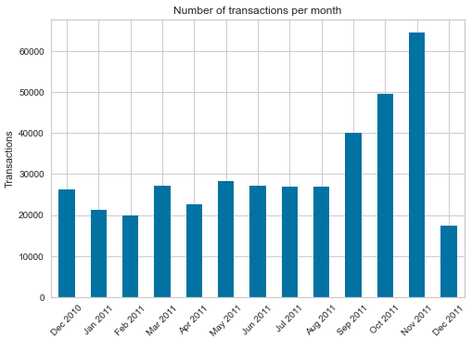
Data Understanding
Data Semantics
Count Null values
65080 CustomerID, 753 ProdDescr
Delete some transactions
Null Sale (1279) & Negative Qta (9752)
Null values
Data distributions and statistics

Slide 4
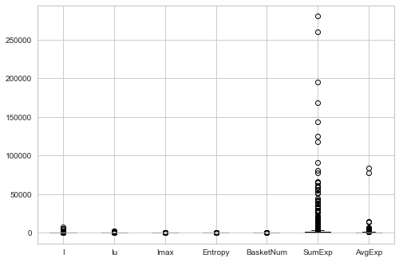
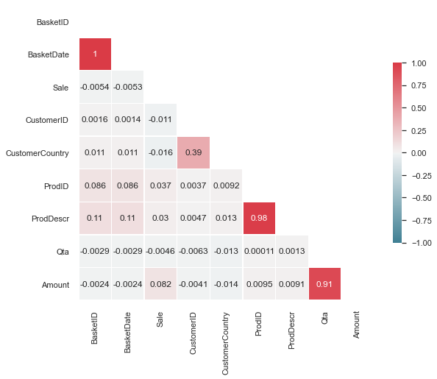
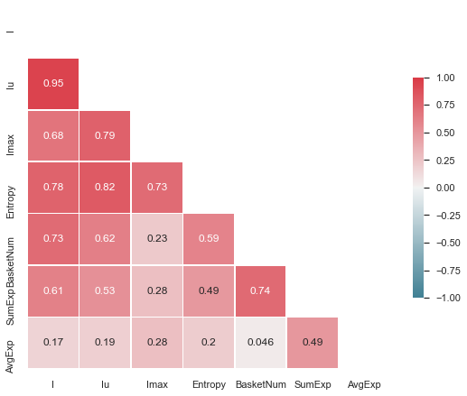
Data Preparation
New Features
I, Iu, Imax, Entropy
BasketNum, SumExp, AvgExp
Outliers Detection
Z-Score > 3
Pairwise Correlation

Slide 5
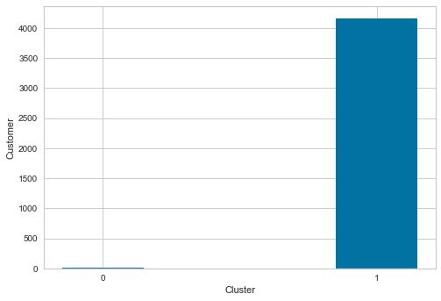
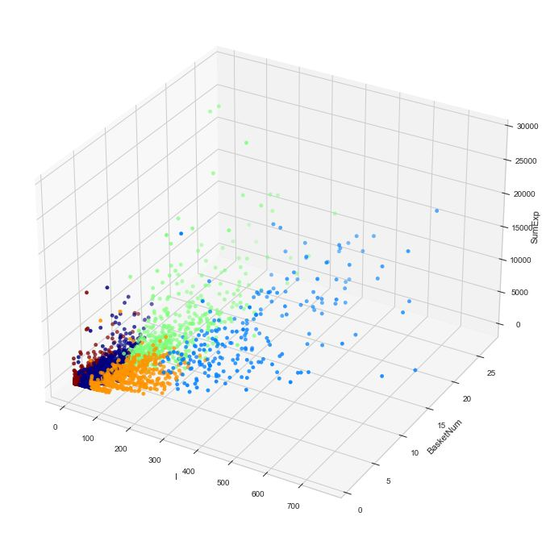
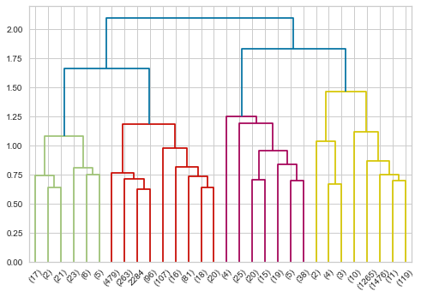
Clustering Analysis
Data Normalization (MinMax scaler)
K-Means (5 clusters)
Elbow Method (to find K)
DBSCAN (2 unbalanced clusters)
min_samples = 2 * dataset dimensionality
Elbow Method (to find epsilon)
Hierarchical
Single, Complete, Average, Ward
Euclidean, Cosine, Manhattan

Slide 6
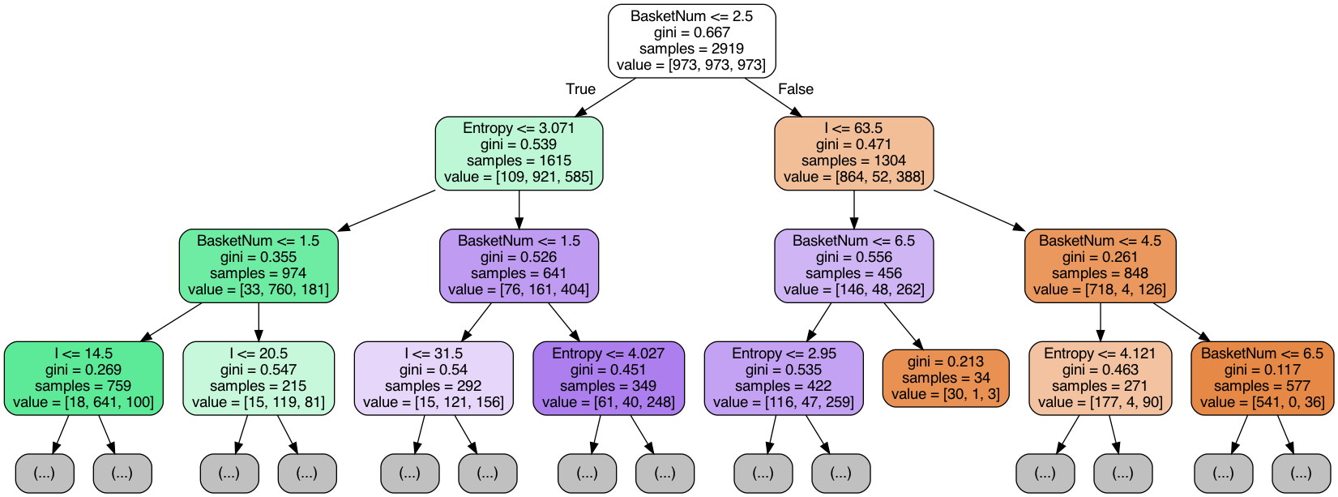
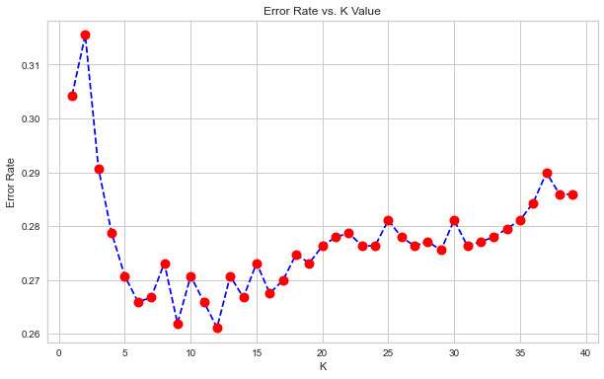
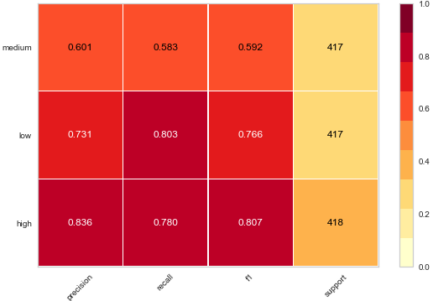
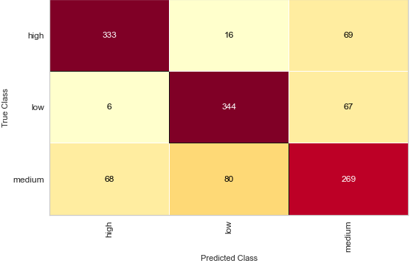
Predictive Analysis
Feature Selection
Labeling: SumExp
Prediction: I, BasketNum, Entropy
Holdout Method (70% - 30%)
Model Selection
Decision Tree
Random Forest
SVM
K-NN
Naive Bayesian
Classification report
Confusion Matrix

Slide 7
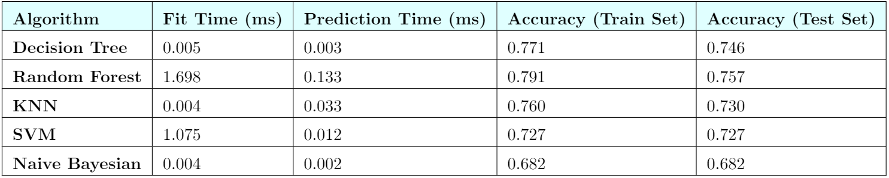
Comparison

Slide 8
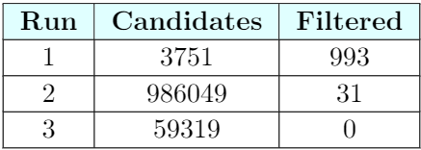
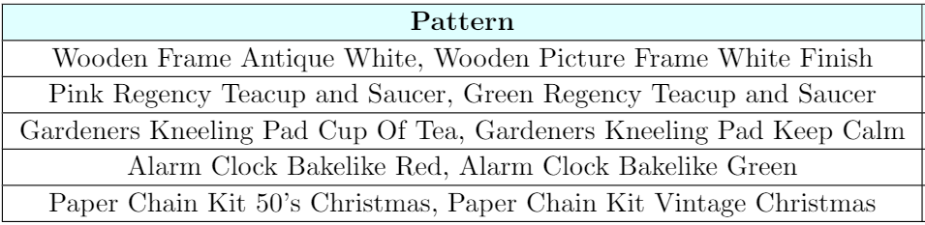
Sequential Pattern Mining
Customers filtering (4171)
Sequence generation (14929)
Sequence filtering (11229)
6 < # items < 80
Results
Variants
Larger sets
Different product fields

Slide 9
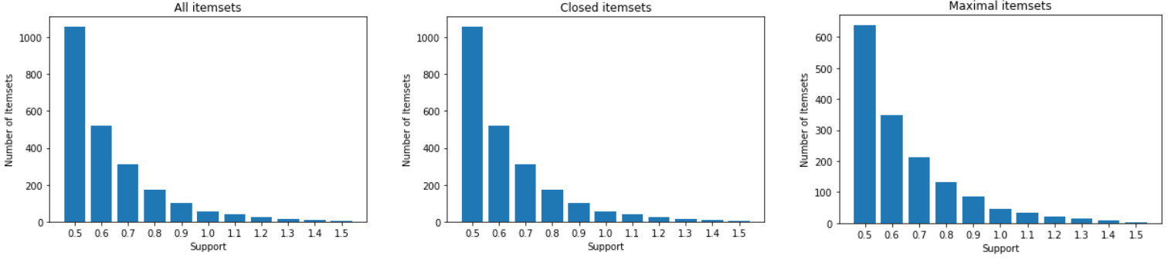
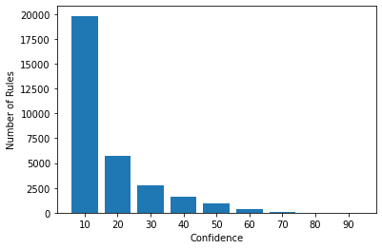
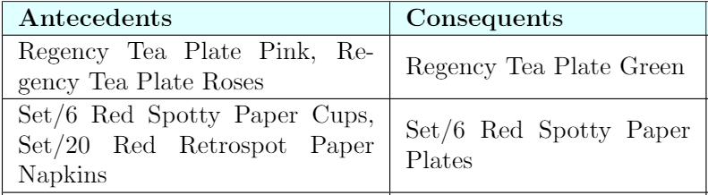
Association Rules Mining
Frequent Itemsets (53)
Support ≥ 1%
Length ≥ 3
Association Rules (94)
Confidence ≥ 70%

Slide 10


